Slide 1
Women Empowerment And Development In India
Group - 11

Slide 2
Outline
What is Women Empowerment ?
Why should it be ?
Existing Problem
Ways to achieve it
Efforts made to achieve it

Slide 3
What is Women Empowerment
Women Empowerment itself elaborates that Social Rights , Political Rights , Economical stability , judicial strength and all other rights should be also equal to women. There should be no discrimination between men and woman. Women should now there fundamental and social rights which they get once they born.
Women Empowerment refers to increasing the spiritual, political, social, educational, gender, or economic strength of individuals and communities of women.
Women’s empowerment in India is heavily dependent on many different variables that include geographical location (urban/rural), educational status, social status (caste and class), and age.

Slide 4
History of Woman Empowerment in India
The position enjoyed by women in the Rig- Vedic period deteriorated in the later Vedic civilization.
Women were denied the right to education and widow remarriage. They were denied the right of inheritance and ownership of property.
Many social evils like child marriage and dowry system surfaced and started to engulf women.
During Gupta period, the status of women immensely deteriorated. Dowry became an institution and Sati Pratha became prominent.

Slide 5
Scenario Has Changed….
During the British Raj, many social reformers such as Raja Rammohun Roy, Ishwar Chandra Vidyasagar and Jyotirao Phule started agitations for the empowerment of women. Their efforts led to abolition of Sati and formulation of the Widow Remarriage Act.
Later, Mahatma Gandhi and Pt. Nehru advocated women rights. As a result of their concentrated efforts the status of women in social, economical and political life began to elevate in the Indian society.

Slide 6
Why Should It Be ?
“Women are worshipped as goddess in INDIA,
But not given her true position.”
MAIN PROBLEMS FACED BY WOMEN IN PAST AND PRESENT
Gender Discrimination
Women Education
Female Infenticide
Dowry
Child Marriage
Atrocities on women: With their age, they have been raped, kicked, killed, subdued & humiliated almost daily.

Slide 7
GENDER DISCRIMINATION
Female work patricipation in india is 25.7% as compared to 51% of men
They are given less payment for same amount of work.
Male child has higher priority then female child.
As per Census of Central Government Employees, in 2001, the female employment in Central Government is 2.92 lakhs which is only 7.53 % of the total employment in Central Government

Slide 8
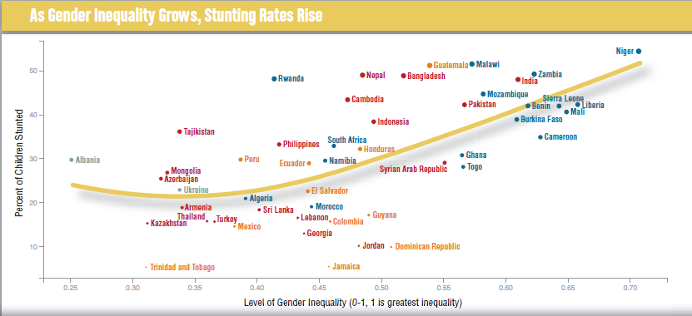

Slide 9
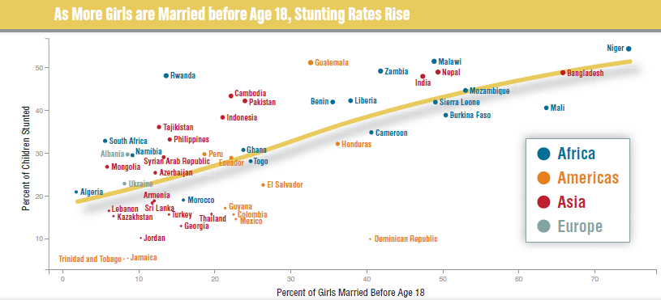
CHILD MARRIAGE

Slide 10
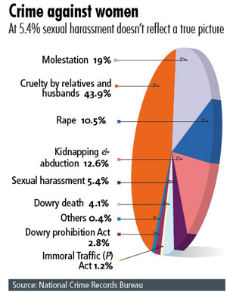

Slide 11
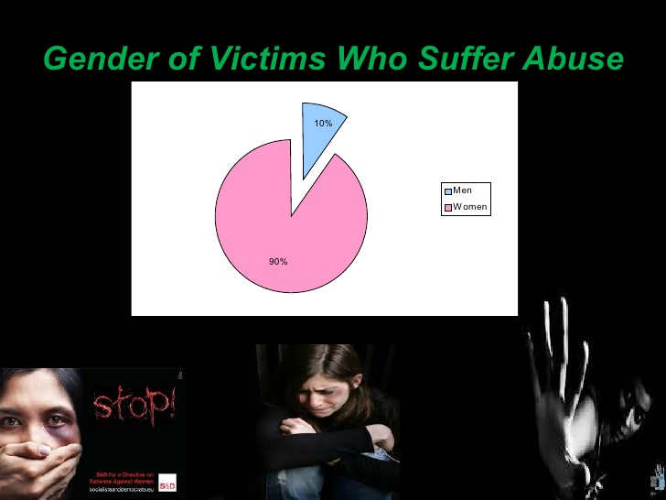

Slide 12
The status of women in India, particularly in rural areas needs to address the issues of empowering women.
Leaving a major number of urban and suburban women, the Indian women are still crying for simple justice. Which is not even allowed to have been accessed to them.
Ironically, women have not actively participated in their own emancipation mainly due to low economic independence.
In agriculture & animal care the women contribute 90% of the total work force.
Women constitute almost half of the population, perform nearly 2/3rd of its work hours, receive 1/10th of the world’s income & own less than 1/100th of the world property.
Among the world’s 900 million illiterate people, women out number men two to one.

Slide 13
The male child perceived as an asset for the landless rural laborer, a dowry earner for a greedy middle class family and a simple matter of pride for the mother.
The existing studies show that the women are relatively less healthy than men even though, they belong to same class.
They constitute less than 1/7th of the administrators & managers in developing countries.
Only 10% seats in world’s parliament & 6% in national cabinets are held by them.
It is ironical that a country, which has recently acclaimed the status of the first Asian country to accomplish its Mars mission in the maiden attempt, is positioned at the 29th rank among 146 countries across the globe on the basis of Gender Inequality Index.

Slide 14
They also suffer from…
Maternal Mortality
Women Trafficking
Malnutrition
Exploitative Practices
Child Marriage
Dowry
Gender Violence
Child Labor
Eve Teasing
Sexual Harassment
Family Abuse
& a lot more…

Slide 15
Some Global Eye Openers
China: Suicidal rates are higher in case of women
Women’s life at risk because of acid attacks in Ethiopia
37% women victims of domestic violence: NFH survey
Almost half of Indian women have not heard of AIDS
Married women, children most anemic in India

Slide 16
Need For Women Empowerment And Area Where Focus Is Need
Lack of education
Financial constraint
Family responsibility
Low mobility
Low ability to bear risk
Low need for achievement
Absence of ambition for the achievement,
Social status
Exposure To Media
Decision making Power
Domestic Violence

Slide 17
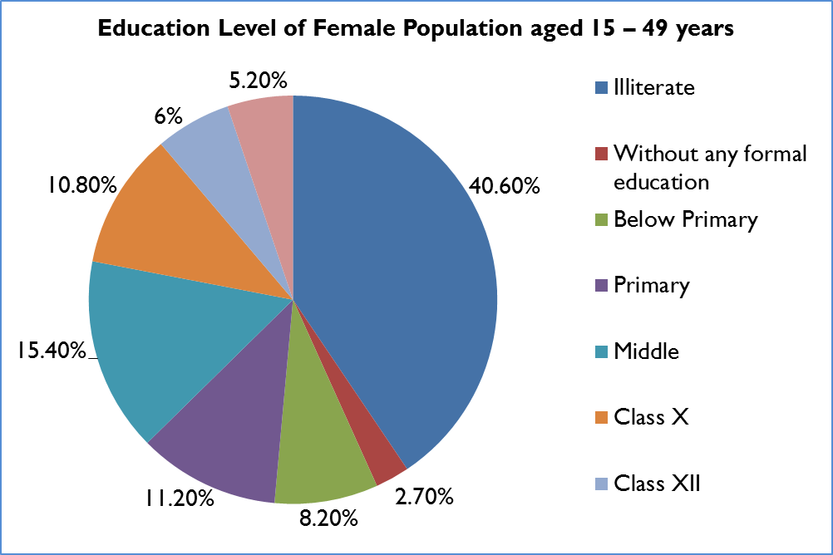
EDUCATION
Children’s school attendance
Only two-thirds of girls and three-fourths of boys age 6-17 years are attending school. The sex ratio of children attending school is 889 girls per 1,000 boys.

Slide 18
EXPOSURE TO MEDIA
About 71 per cent of women are exposed to media as compared to 88 per cent in case of men.
Twenty nine per cent of women do not have access to media regularly. Since it is an important source of empowerment, greater proportion of women without having access to media reflects the relatively disadvantageous position of women in relation to men with regards to empowerment.
ACCESS TO EMPLOYMENT
Women age 15-49 are about half as likely as men in the same age group to be employed: 43% vs. 87%.
Even with controls for education, age, and wealth, marriage is negatively associated with a woman’s likelihood of being employed and is positively associated with a man’s likelihood of being employed.
Most employed women work for someone else, away from home,and continuously throughout the year; about one in three women do not receive monetary compensation for their work or receive at least part of their payment in kind.
Most employed women work in agriculture; only 7% work in professional,technical, or managerial occupations.

Slide 19
FAMILY RESPONSIBILITY
Most of the women in Rural and even in urban areas are Housewives. They have been busy with the family responsibility and their work is not even given enough respect as it has no economic output.
In case of rural areas, women along with maintaining household they work at farms and even take care of animals.
DECISION MAKING POWER
Among those who have earnings, more women (1 in 5) than men (1 in 18) do not have a major say in how their own earnings are used and fewer women (about 7 in 10) than men (about 9 in 10 men) have a major say in how their spouses' earnings are used.
Less than two in three currently married women participate, alone or jointly, indecisions about their own health care, large household purchases, purchases for daily need, and visits to her family and relatives.

Slide 20
Domestic Violence
About two in five currently married women age 15-49 have experienced spousal violence in their current marriage, and among women who have ever experienced such violence.
Higher education and wealth consistently lower women’s risk of spousal violence, and husbands’ consumption of alcohol and having a mother who was beaten by her spouse significantly increase the risk.
Although women who agree that wife beating is justified have a higher prevalence of violence, one out of three women who do not agree that wife beating is justified have also experienced violence.

Slide 21
SCHEMES BY GOVERNMENT
Rashtriya Mahila Kosh (RMK), 1993
This scheme created by the government of India with the purpose to provide the loan to poor women to begin small businesses.
Priyadarshini, 2011
Priyadarshini is a pilot programme for Women Empowerment. This scheme offers women in seven districts, access to self-help groups and promotion of livelihood opportunities.
Central Social Welfare Board (CSWB), 1953
This scheme launched to promote social welfare activities and appliance welfare programmes for women and children through spontaneous organizations.
Short Stay Home for Women and Girls (SSH), 1969
This scheme provides temporary residence to women and girls who are in social and moral danger due to family problems, mental strain, violence at home, social ostracism, exploitation and other causes.
Swadhar, 1995
This scheme support women to become independent. Swadhar makes women to be strong and independent by spirit, by thoughts and by action and provide full control over their lives rather than be the victim.
SwayamSiddha, 2001
This scheme organizing women into self help group.

Slide 22
SCHEMES BY GOVERNMENT
Mother and Child Tracking System (MCTS), 2009
This program helps to monitor the health care department to ensure that all mothers and children have access all the required services and medical care, during pregnancy and delivery. Also the system maintains a database of all pregnancies registered and all births from 2009, December.
Indira Gandhi Matritva Sahyog Yojana Conditional Maternity Benefit plan (IGMSY-CMB), 2010
This scheme sponsored by the Central Government for pregnant women age 19 and over for their first two live births. This program provides money to help better health and nutrition of the pregnant women. The beneficiary gets 4000/- in 3 installments. Any government employee doesn’t come under this scheme.
Rajiv Gandhi Scheme for Empowerment of Adolescent Girls – Sabla (RGSEAG), 2012
This scheme targets adolescent girls of 11 – 18. The scheme offers a package of benefits for improving their health and nutrition. This program offers many services on central level to help women to become Self Supporting, to get nutritional supplementation, education, education of health, life skills and various types of vocational training.

Slide 23
Major landmark steps taken in India by Law
Under the Constitution of India such as: Right to equality under Article 14 of the Indian Constitution guarantees to all Indian women equality before law.
Equal pay for equal work under Article 39(d), guards the economic rights of women by guaranteeing equal pay for equal work; and Maternity Relief under Article 42, allows provisions to be made by the state for securing just and humane condition of work and maternity relief for women.
Acts like the Dowry Prohibition Act, 1961, prohibits the request, payment or acceptance of a dowry. Asking or giving dowry can be punished by imprisonment as well as fine.
Protection of Women from Domestic Violence Act, 2005, provides for a more effective protection of the rights of women who are victims of domestic violence.
Sexual Harassment of Women at Work Place (Prevention, Prohibition and Redressal) Act, 2013, helps to create a conducive environment at workplace for women where they are not subjected to any sort of sexual harassment.

Slide 24
ROLE OF NGOs
Swayamsidha Programme
Additionally, the Ministry is also implementing the Swayamsidha programme – an integrated scheme for the empowerment of women at a total cost of Rs. 116.30 Crores. Core to this programme will be the establishment of women’s self-help groups which will empower women to have increased access to all kinds of resources that they are denied, in addition to increasing their awareness and skills. This programme will benefit about 9,30,000 women with the setting up of 53,000 self-help groups, 26,500 village societies and 650 block societies.

Slide 25
Various NGO’s working for Woman Empowerment in India
PRS Legislative Research
Honey Bee Network(established by IIM-A professor Anil Gupta) :- Workshop held in IET Auditorium by Anil Gupta
SRISTI (Society for Research and Initiatives for Sustainable Technology and Institutions) which works in four domains of innovation: Educational, Cultural, Technological and Institutional innovations.
Smile Foundation
CARE
Digital Empowerment Foundation
Aarzoo
Save Life Foundation
CGNet Swara
Chetna
Pravah
Centre for Social Research

Slide 26
SUGGESTIONS
Proper awareness for laws should be there that is law should not be restricted to papers only but the implementation of law should be there so that every woman can be familiar with her rights. Significant steps should be taken to implement all the laws which are amended to facilitate detention, prevention and punishment of crimes against women.
Women education has to be made compulsory and women should be encouraged to become literate because without being educated women cannot have a access to her right.
Strict implementation of the schemes and policies for women empowerment should be done.
Awareness camps for women should be organized where they can become familiar with the framed schemes and policies and can take benefit of those schemes and policies.

Slide 27
Moreover we need to change our way of thinking and should work for women empowerment. We need to develop sisterhood so as to provide safeguard to women.

Slide 28
And At Last
There is no chance for the welfare of the world unless the condition of women is improved, It is not possible for a bird to fly on only one wing.
- Swami Vivekananda

